Slide 1
CUMULUS Mainframe to Cloud Modernization Fabric —

Slide 2
Background and Technical problem
BACKGROUND
Traditionally it has been an aspiration from many customers to be able to modernize a Mainframe or IBM I Systems, but they present some characteristics that need to be taken in consideration:
It is the result of many years of investment & development efforts done by different teams and companies
It has a huge number of software components: Thousands of programs, Millions of Line of Code, Thousands of databases, etc.
It present what’s called “application spaghetti”: a huge number of relationships between software components
Normally it exists a lack of knowledge about FUNCTIONAL & TECHNICAL applications, their software components and their relationships
TECHNICAL PROBLEM
It exists different approaches to modernize these systems but all of them need to face with some challenges:
Projects costs, starting > 10 M € growing to > 100 M €
Projects term, between 5 to 10 years
Modernization scope: How to determine the components to be modernized?
The huge number of components to be considered (100 K programs, 100 M Lines of Code, etc..)
Technical Complexity because of the relationships between software components
Extreme complexity in the integration and coexistence between legacy and modernized system.
Lack of knowledge about the systems and their relationships
Risks, with a long story of failed projects

Slide 3
Technical Solution
CUMULUS is a Method based on a Full Stack Application that allows to identify and stablish optimal modernization roadmaps for mainframe and IBM I:
Systems Modelling
Discovery of Technical Application Map (using existing tools)
Enrichment process:
Business information
Economical Data (MIPS, Tickets, etc)
Application of ML techniques to investigate modernization options (What’s If Analysis)
Clustering iteration in order to identify “Application CUMULUS”, group of applications to be modernized together
Clustering algorithm using relationships
Modernization Framework: Priorization of modernization roadmap, based on “boosters” or “barriers” variables: MIPS consumption, number of tickets, size, functional importance (wip), etc.
Calculation of Modernization Index
Based on the concept of “CUMULUS” group of applications that are recommended to be modernized together from technical & economical point of view. CUMULUS are obtained using clustering on relationships between application components
1-Application Discovery
2.Technical Enrichment
3.Functional Enrichment
Foundational Tools
-ADDI
-CAST AIP
External Integrations
-DDF, MQ, CTG
Data Domain
MIPS Consumption
Incident Tickets
Usage
Business organization
Application functional structure
4.Application Knowledge
5.Clustering Iteration
6.Modernization Framework
What’s If Analysis:
- Application Component
- Upstream relationships
- Downstream relationships
Cumulus size
Cumulus selection
…
Boosters
Barriers
…

Slide 4
Tecnhical inventive steps
CUMULUS is a Method based on a Full Stack Application that allows to identify and stablish optimal modernization roadmaps for mainframe and IBM I. It is based on the CUMULUS concept (optimal group of applications to be modernized together) and implementing a Modernization Framework that allow to prioritize the modernization roadmap.
STEP 1: Modelling of the system to be modernized (prebuilt but can be adapted to each customer)
STEP 2: Discovery of Technical Application Map (using existing tools) and loading it at CUMULUS database
STEP 3: Enrichment process, obtaining and loading at CUMULUS database
Business information
Economical Data
SETP 4: Application of ML techniques to investigate modernization options (What’s If Analysis)
STEP 5: Clustering iteration in order to identify “Application CUMULUS”, group of applications to be modernized together
Application of different Clustering algorithm (mainly Louvain) using the number of relationships between the applications
STEP 6: Modernization Framework: Priorization of modernization roadmap, based on “boosters” or “barriers” variables: MIPS consumption, number of tickets, size, functional importance, etc.
Modernization Index: Obtention of a calculated value that classify the CUMULUS according to Modernization framework
STEP 7: Results: Generation of reports about the modernization project

Slide 5
Technical Inventive Steps
CUMULUS process & application
USER INTERFACE
System adaptation to each customer needs
Modeling system to be modernized
Graph Database design & implementation
Automatic
What’s-If Analysis
Visual Analysis using Neo4J tools
Discovery Phase
Mannually
Application Discovery Process
Application Source Code
Databases and files
Transactions
Batch Process
Mannually
What’s If analysis with Cypher
Reports
Modernization Roadmap
Priorization
Application Information detail
Relationship information
Complexity
Costs
Timeline estimation
Extraction Process from Discovery tools
Automatic
Load CUMULUS Database
Automatic
CUMULUS and priorization
Enrichment Phase
Clustering process
Enrichment Information Discovery Process
Functional structure
Application usage
Consumption
Incident Tickets
Automatic
Automatic
Priorization Process using Modernization Framework
Enrichment information preparation
Automatic
IT EXIST OTHER TOOLS
COULD EXIST SIMILAR WAYS TO DO THE SAME
UNIQUE FEATURE
Automatic / Mannually
Modernization Index

Slide 6



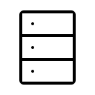
Technical Components
EXCEL REPORTS
Modernization roadmap
Detailed Modernization roadmap
What’s-If Analysis
Application Components
Relationships TO other applications
Relationships FROM other applications
….
CUMULUS USER INTERFACE: VUEJS
Information stored at database
PYTHON PROGRAMS
Discovery tools extraction
Load technical csv files into Cumulus Database
Load functional csv files into Cumulus Database
Relationship assignment and weighting
Clustering process
Modernization Framework
Priorization Index
APPLICATION MAP | CLUSTERING PROCESS | MODERNIZATION FRAMEWORK
Relationship between Functional & Technical components | Parameters (size, etc) | Used Properties
Software components, his properties and the relationships between them | Detail of each cluster iteration: stucks, growing, etc | Boosters & Barriers
Functional structure and his properties | Communities and applications per each community | Priorization Index
Neo4J Graph DB
Infrastructure: Windows, MAC, Openshift (database)

Slide 7
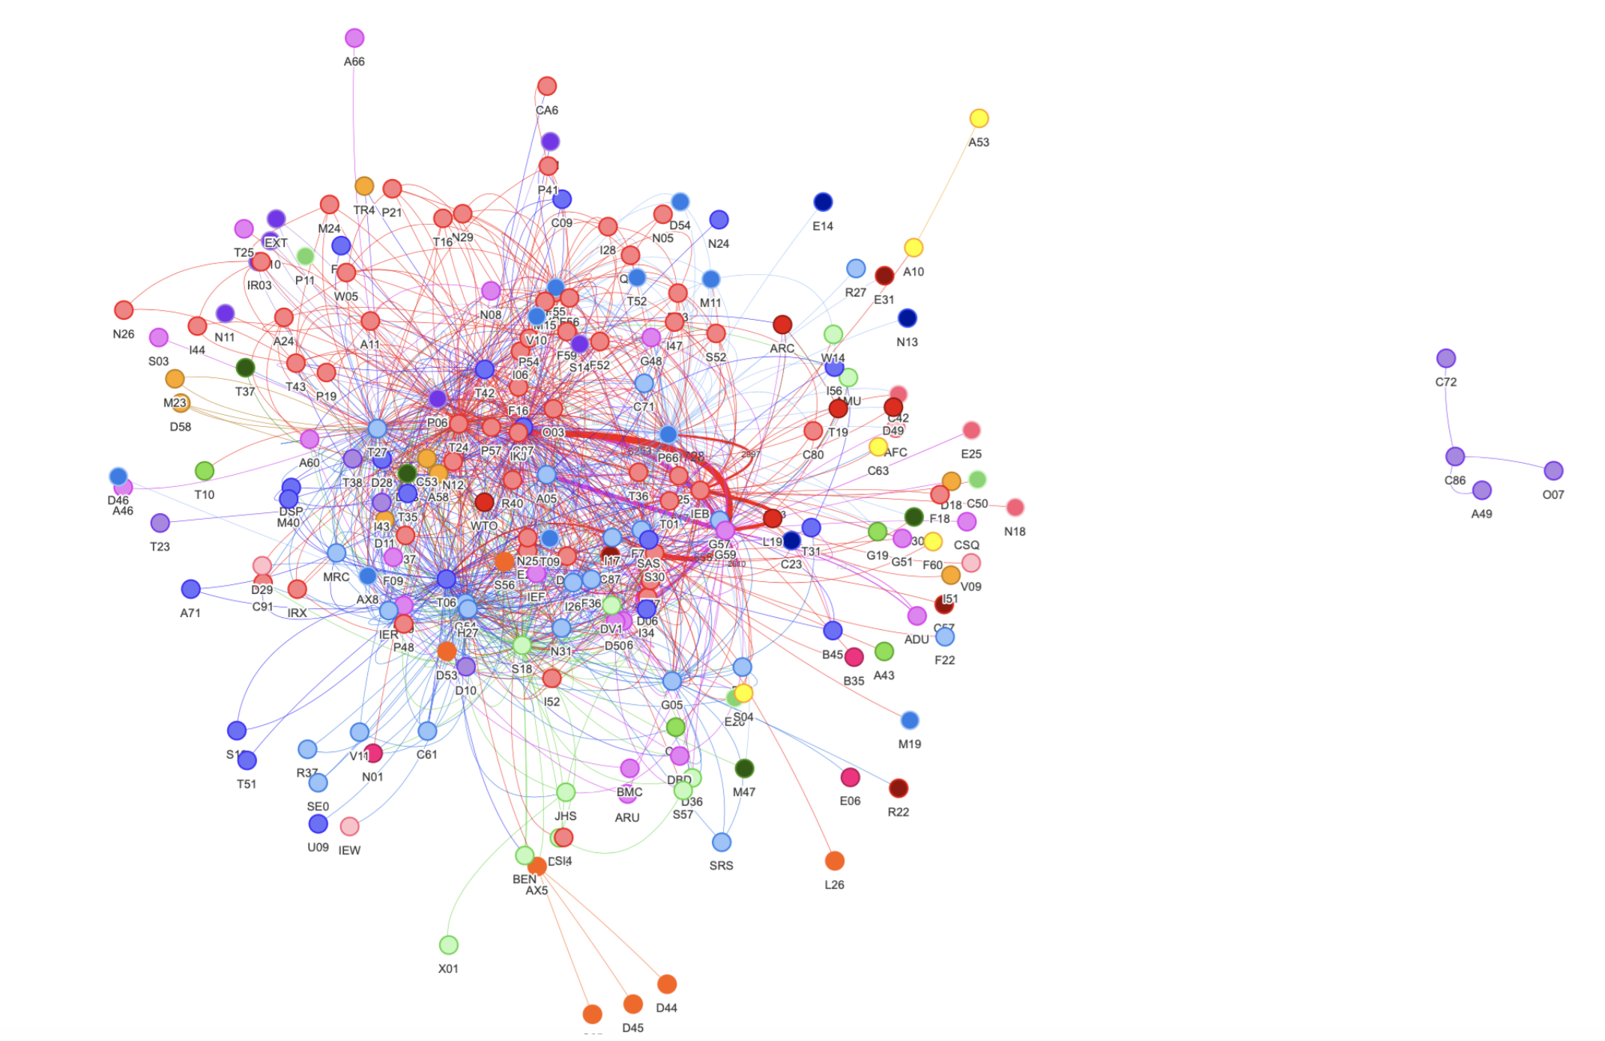

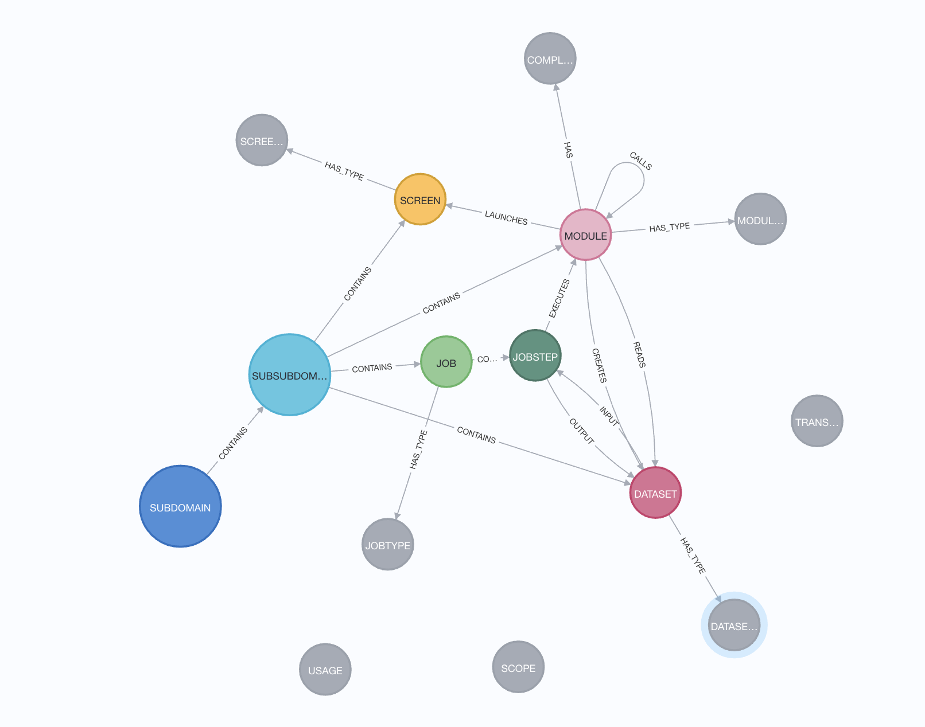

0-Information System modelling
1-Application Discovery & Enrichment
2-CUMULUS Database Loading
CUMULUS USER INTERFACE
3.-
- ADDI
- CAST
- Caravel
- …
0.- Consulting
4.- Consulting
<1.- model.csv>
<data.csv>
CUMULUS
Neo4J DB
5.- Python pgm
6.- Python pgm
2.- Python pgm
<appdata.csv>
Database with information about applications, his components and relationships between components
Note: it exist a predefined model for mainframe, IBM I and Java
5.1.- Python pgm
0.- The information system must be modelled identifying:
Nodes or information objects
Properties of each type of objects
Type of relationships between objects
1.- This model it’s defined in a csv file and load at Neo4j using a Python script
2.- In the process the CUMULUS model it’s created at database
3.- Execution of discovery tools analyzing the application source code components
These tools store the results in their database
4.- Consulting works in charge of discover functional and economical information
The results are stored in CSV files
5.- Execution of Cumulus scripts to download information from Tools database into csv files
5.1.- Execution of CUMULUS scripts to load from CSV files into CUMULUS Neo4j DB
6.- Execution of CUMULUS scripts to load from Enrichment CSV files INTO CUMULUS Neo4j DB

Slide 8
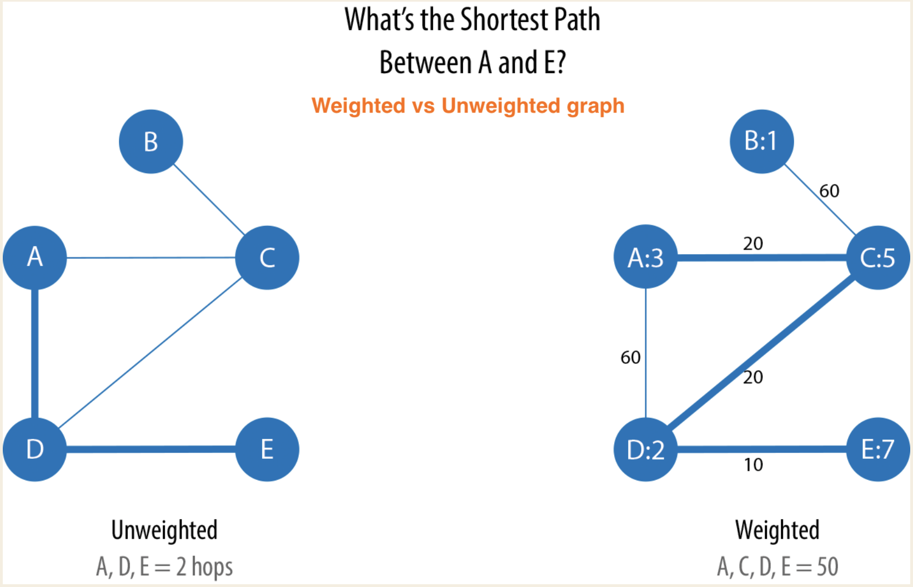
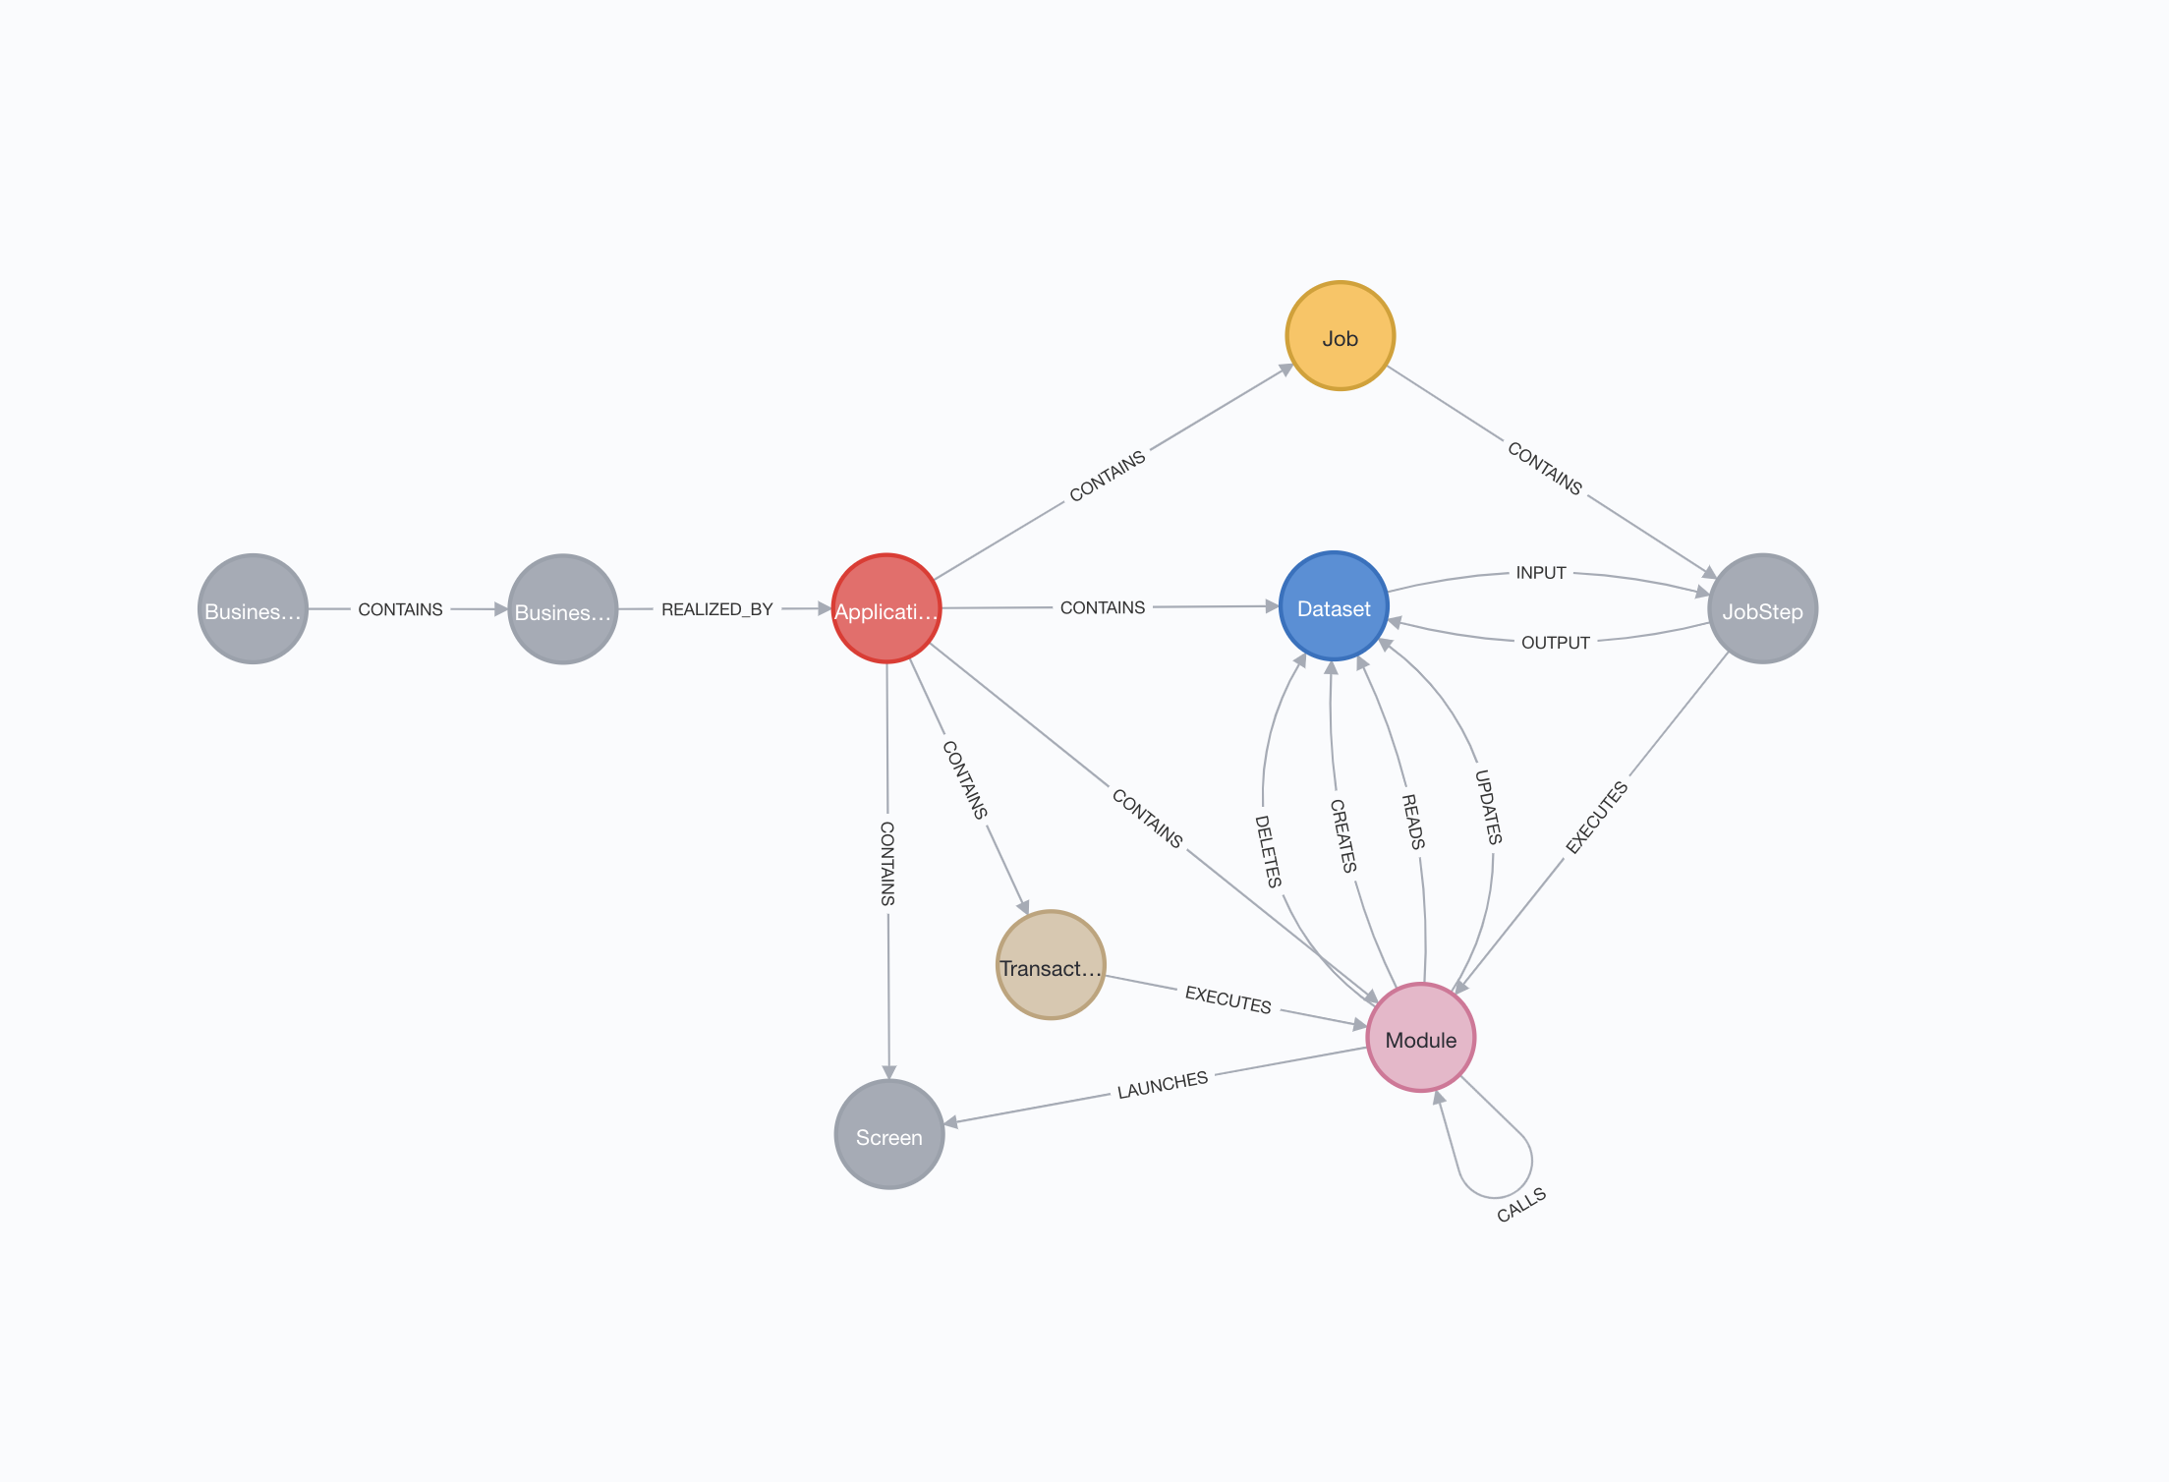
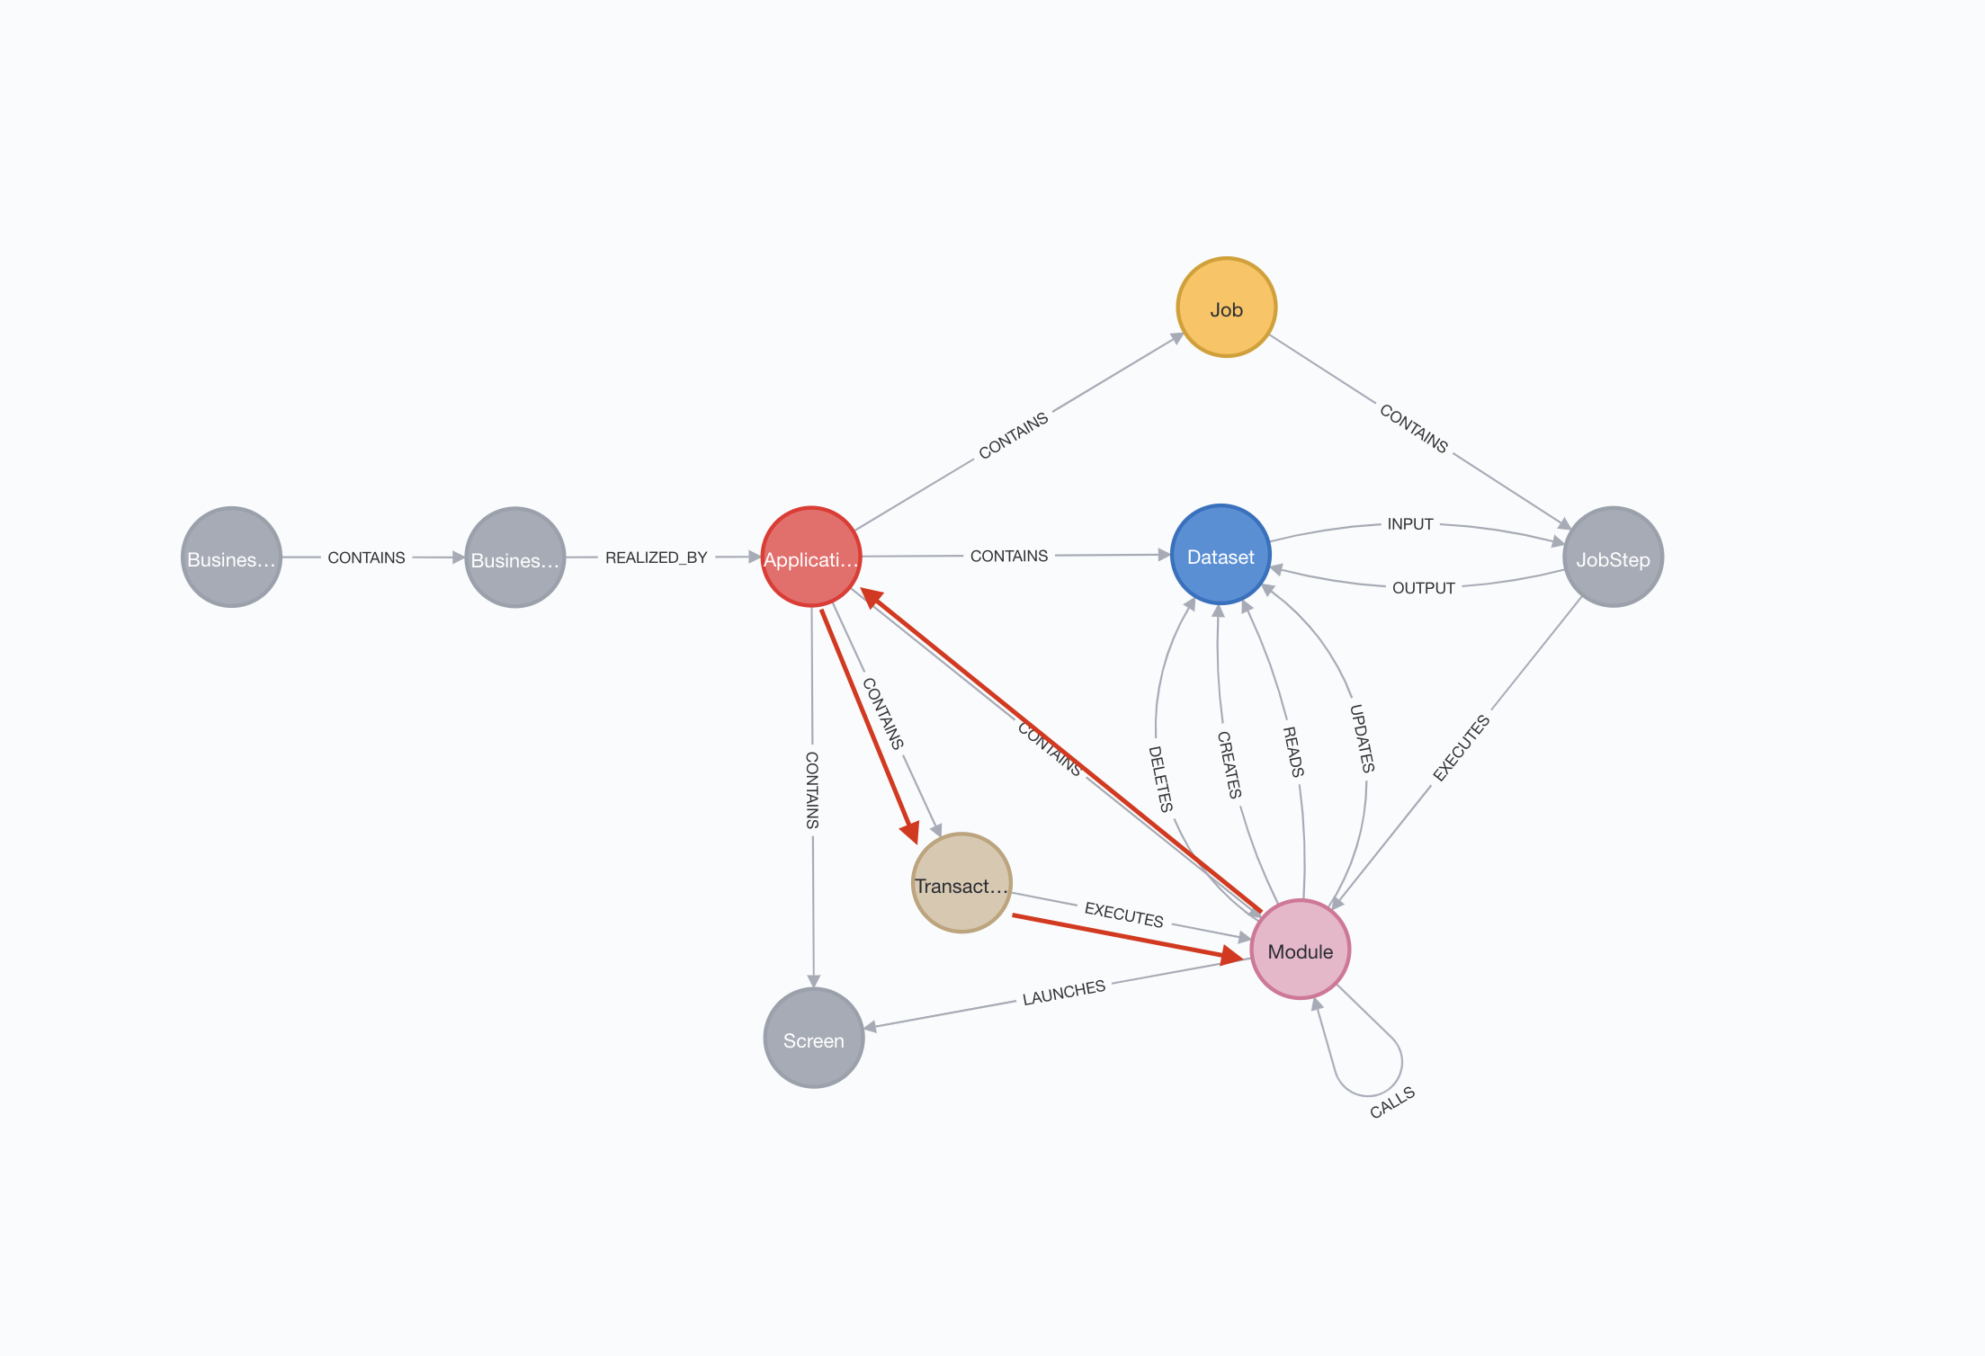
3-Relationship finding and weighted
CUMULUS USER INTERFACE
Neo4J DB
Neo4J DB
7.- Python pgm
Mathematically, the shortest path between 2 points can be different if it’s assigned a weight to the different alternatives
CUMULUS algorithms are based on this math concept and for that reason need to calculate the type and number of relationships between software objects.
Database with information about applications, his components and relationships between components
Database with information about applications, his components, and number of relationships between components
Based on input data and his model, Cumulus automatically finds the relationships between different applications. It then needed to create weighted relationships between the app’s nodes.
7.- CUMULUS use python programs to launch custom cypher queries that count the following application connections:
An app’s job executing a module contained by another app
An app’s transaction executing a module from another app
Two apps containing the same module
An app module accessing a dataset also accessed by another app’s module
An app’s job accessing a dataset accessed by another app’s job

Slide 9
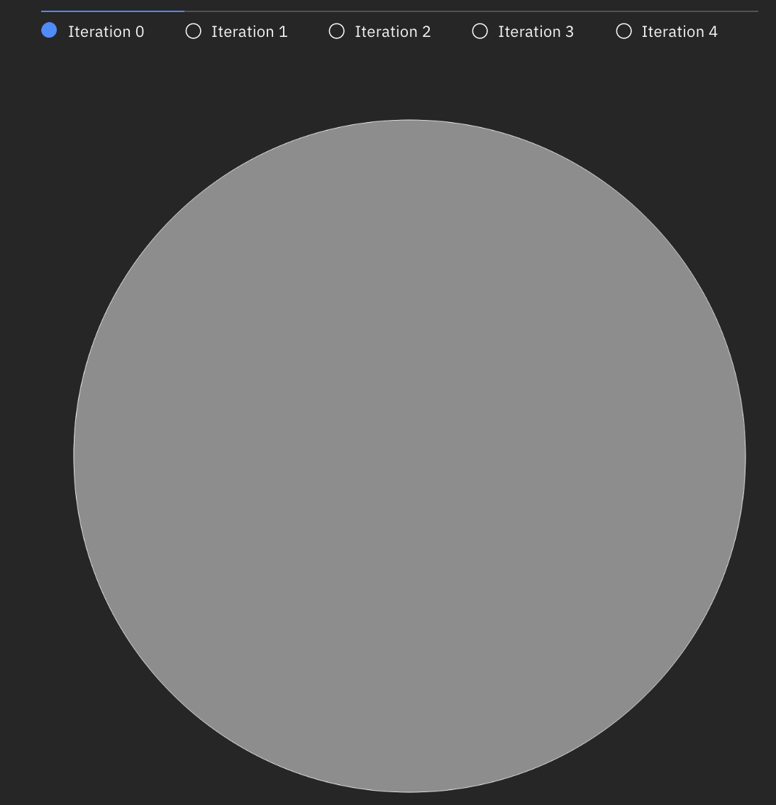
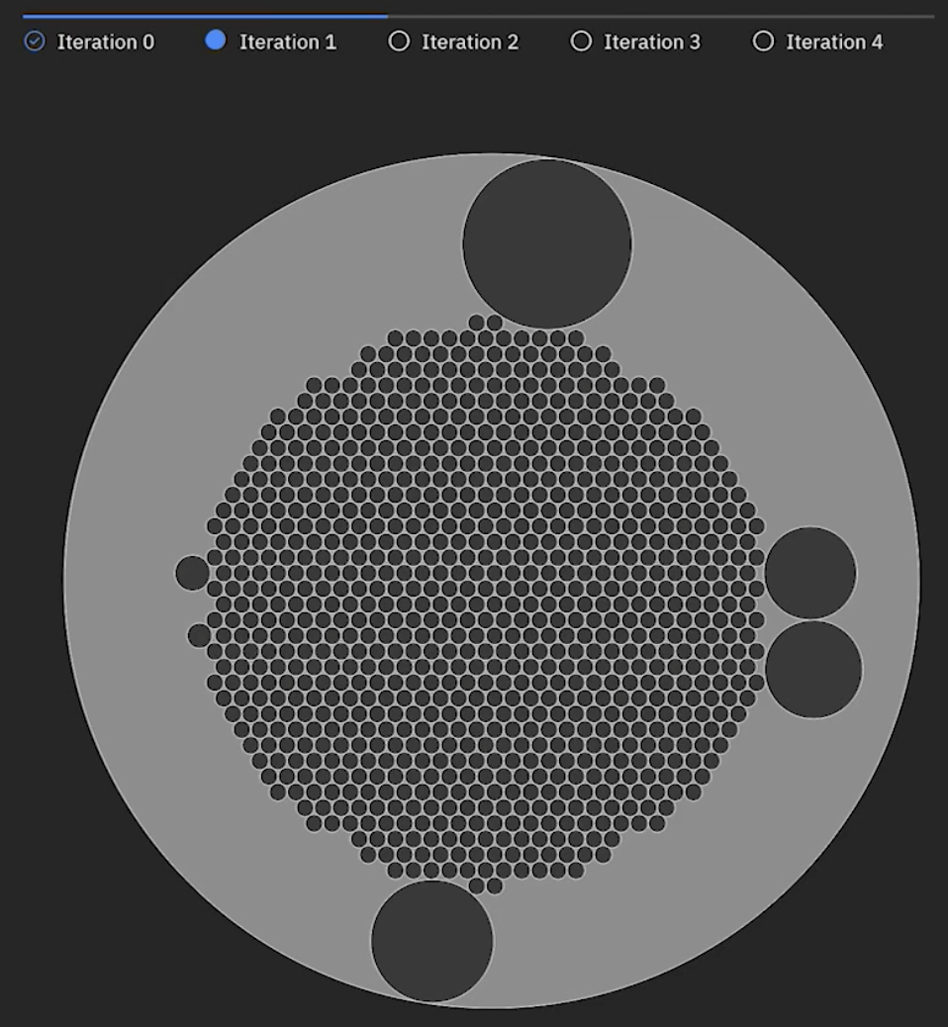
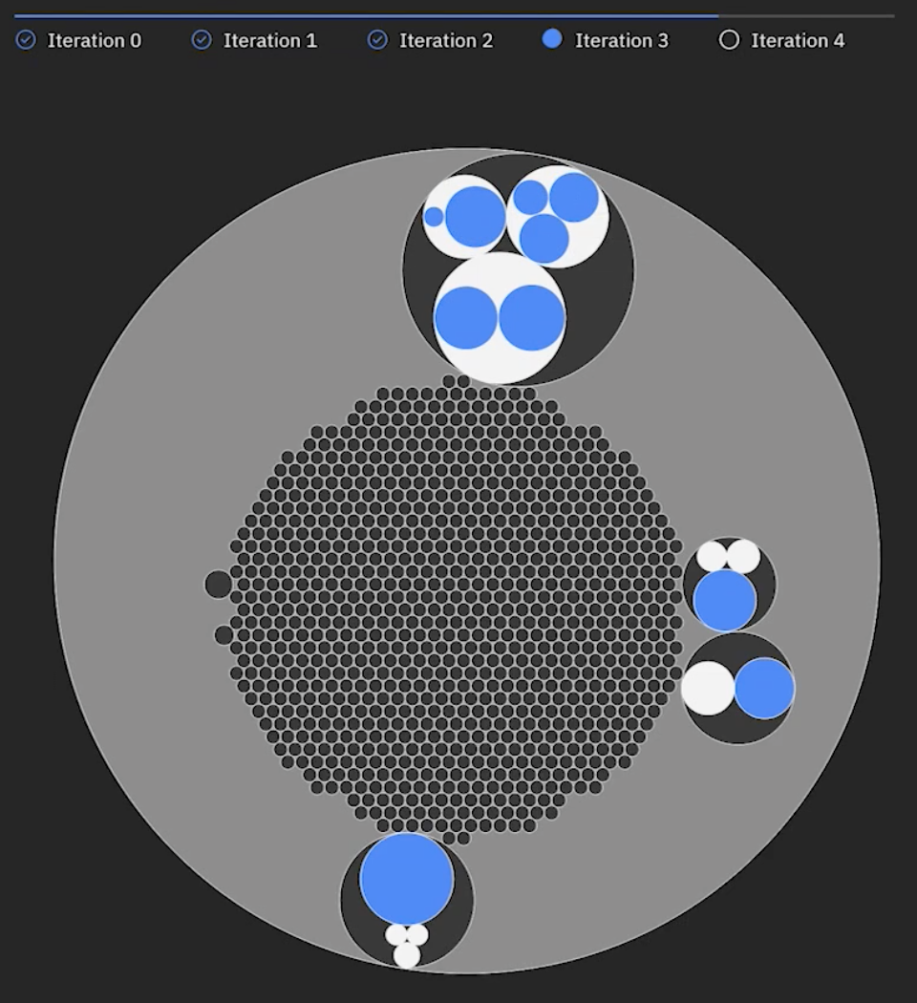
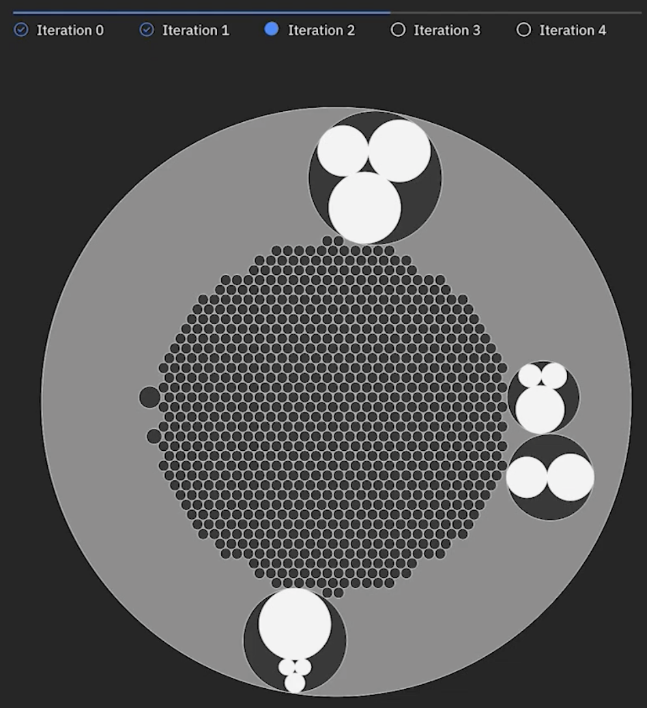
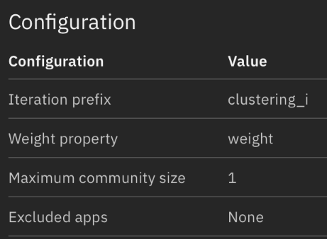
4- CLUSTERING
Once obtained the relationships & weights between applications, CUMULUS can start the clustering stage
The objective of clustering process it’s to identify optimal group of applications with maximum inner coupling and minimum external coupling
CUMULUS concepts
Community or Cumulus: A community is a number of applications grouped by the number of relationships and weight between their applications components.
Clustering process: Cumulus apply clustering math algorithms that allow to identify the communities
Maximum community size: Maximum number of applications to be included in a community.
Must be defined at beginning of the process
Stuck community: Community that’s below the maximum community size
Growing community: Community that’s above the maximum community size
CUMULUS clustering program: Python program that execute iteratively on CUMULUS database in order to detect communities applying CUMULUS algorithms & concepts
Iterative iterations executing the clustering program allow to decompose that huge community in smallest communities (with smallest number of application) in each iteration
Results of each iteration are stored at same CUMULUS database
STEPS
First iteration of CUMULUS clustering program will consider one cumulus that include all applications
The first iteration apply the clustering algorithms and decompose the initial cumulus in different communities:
Stuck: These communities has a size below the limit and then will not be considered at next iterations
Growing: Next clustering iteration will be applied on these communities
Each iteration produce stuck applying the clustering algorithm over the growing
The process will stop
All cumulus are below the maximum
The system detect that’s impossible to divide more the growing communities
The user decide to stop
The process can be repeated as needed changing community size
CUMULUS USER INTERFACE
Iteration 0: One community
Iteration 1: Several growing and stucks communities
Iteration 2: Growing are divided into stucks and produce new stucks (in white)
Iteration N: All Cumulus are below the maximun
Parameters
Clustering pgm
Clustering pgm
Clustering pgm
Neo4J DB
Neo4J DB
Neo4J DB

Slide 10
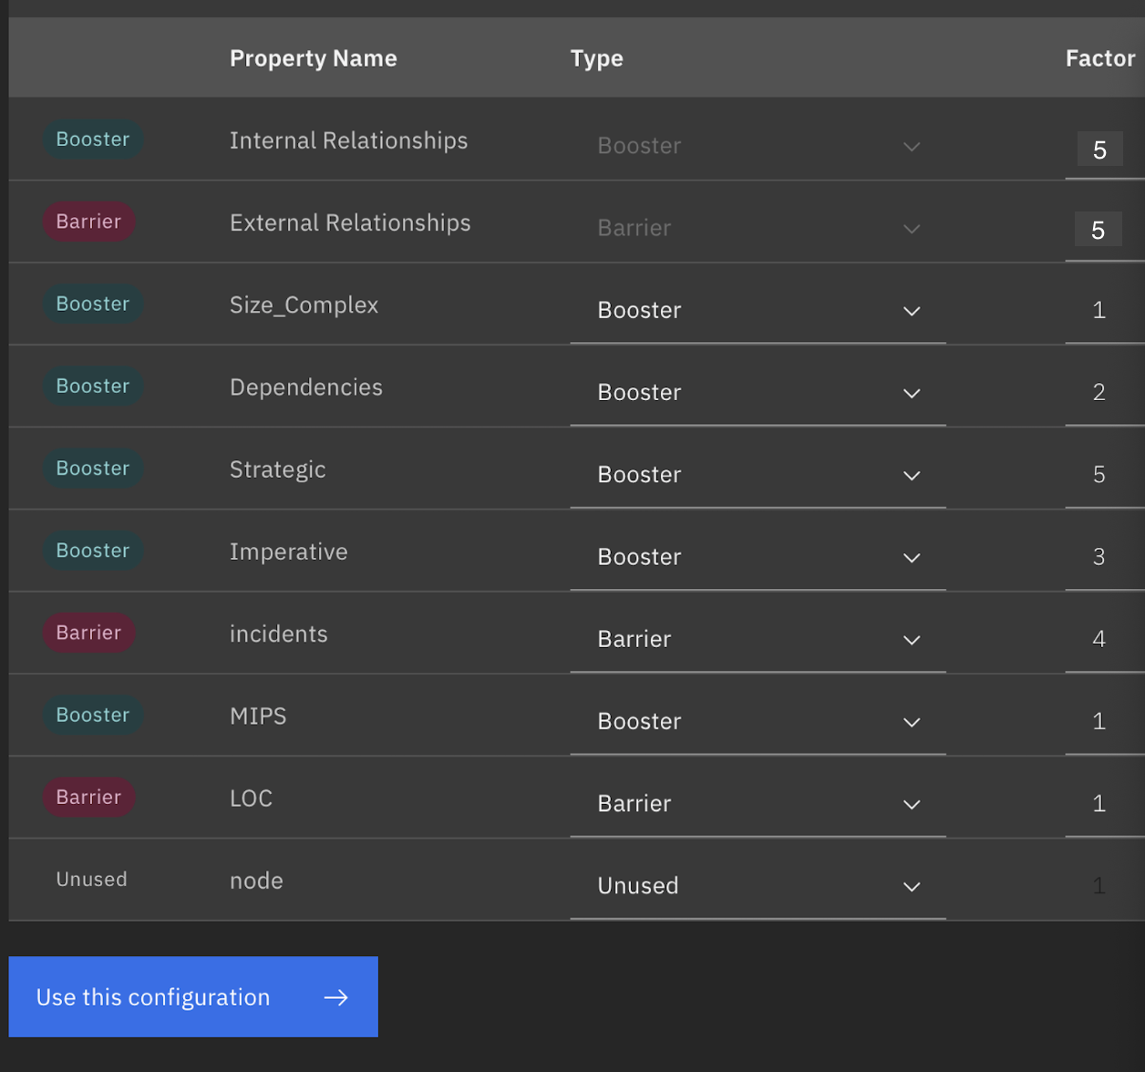
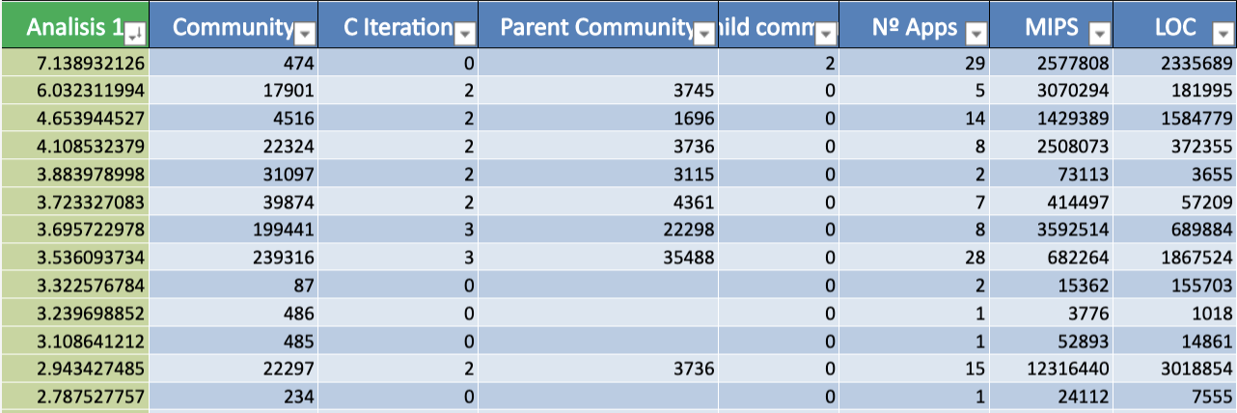
5 – MODERNIZATION FRAMEWORK & RESULTS
CUMULUS Modernization Framework allow to classify and prioritize the application according to different concepts
Property
Modernization Factor – Boosters & Barriers
Modernization Index
This classification will determine the Optimal Modernization Roadmap
CUMULUS USER INTERFACE
Selection of Properties, boosters & barriers
Reports generation
Priorization pgm
Neo4J DB
1. Modernization Factor Boosters & Barriers
2. Modernization Index
3. Results
0.Property
Cumulus allows to use Properties from the enrichment stage to be applied on the roadmap. By default (can be added more) it include:
Technical properties:
Relationships (internal/external)
Size or complexity
Lines of Code
Economical properties
MIPS consumption
Number of incidents
Functional properties
Strategic
Imperative
…
Modernization Factor: Configurable value used to increase / decrease the importance of a property
Boosters: Recommend to modernize a Cumulus. Can be assigned to each property.
Barriers: Recommend NOT to modernize a Cumulus. Can be assigned to each property.
Based on Properties, his classification like boosters or barriers and the modernization factor, Cumulus calculate a Modernization Index.
Once calculated the Modernization Index, Cumulus can generate different types of reports:
Prioritized roadmap ordered by the Priorization Index including for each CUMULUS his main values: Nº of applications, MIPS, Internal & External Relationships, LOC, etc
Detailed report about each CUMULUS , his applications and the detail of theses applications
It’s possible to make CYPHER queries over all the information load at the database

